Slide 1
Pig
Prof. Sarada Samantaray
M. Tech (CS)
Associate Dean, NMIMS University

Slide 2

What is Pig?
Pig performs a series of transformation to data relations bases in Pig Latin statements
Relations are loaded using schema on read semantics to project table structure at runtime
You can run Pig Latin statements interactively in the Grunt shell, or save a script file and run then as a batch

Slide 3

Relations
A relation is an outer bag
A bag is a collection of tuples
A tuple is an ordered set of fields
A field is a data item
A field can contain an inner bag
A bag can contain tuples with non-matching schema
{(a,1)
(b,2)
(c,3)
(d,{(4,5),(6,7)})
(e)
(f,8,9)
}

Slide 4
What kinds of things can I do with Pig?
-- Load comma-delimited source data
Readings = LOAD ‘/weather/data.txt’ USING PigStirage(‘,’) AS (date:chararray, temp:long);
-- Group the tuples by date
GroupedReading = GROUP Readings BY date;
--Get the average temp value for each data
GroupedAvgs = FOREACH GroupedReading GENERATE group, AVG(Readings.temp) AS avgtemp;
--ungroup the dates with the average temp
AvgWeather = FOREACH GroupedAbg GENERATE FLATTEN(group) AS date, avgtemp;
--Sort the results by date
SortedResults = ORDER AvgWeather BY date ASC;
-- Save the result in the ‘/weather/summary folder
STORE SortedResults INTO ‘/weather/summary’;
2017-06-01, 32
2017-06-01, 38
2017-06-01, 35
2017-06-02, 30
2017-06-02, 33
2017-06-02, 30
….
2017-06-01 35.00
2017-06-02 31.00

Slide 5
Common Pig Latin Operations
LOAD
FILTER
FOREACH … GENERATE
ORDER
JOIN
GROUP
FLATTEN
LIMIT
DUMP
STORE

Slide 6
Pig generates Map Reduce jobs for each of the Pig Latin statements
Jobs are executed on:
DUMP
STORE
Readings = LOAD ‘/weather/data.txt’ USING PigStirage(‘,’) AS (date:chararray, temp:long);
GroupedReading = GROUP Readings BY date;
GroupedAvgs = FOREACH GroupedReading GENERATE group, AVG(Readings.temp) AS avgtemp;
AvgWeather = FOREACH GroupedAbg GENERATE FLATTEN(group) AS date, avgtemp;
SortedResults = ORDER AvgWeather BY date ASC;
STORE SortedResults INTO ‘/weather/summary’;
Jobs executed here

Slide 7
Pig DEMO

Slide 8
How do I run a Pig script!
Save a Pig Latin script file
Run the script using Pig
Consume the result using any tool/software
For example, excel or power BIDefault output does not include schema – just data

Slide 9
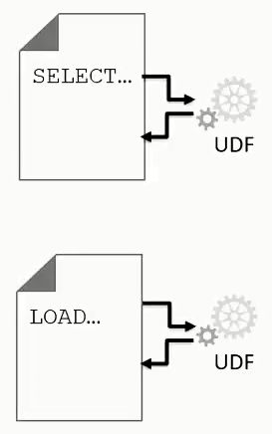
What is UDFs
User-Defined Function (UDFs) extend the capabilities of Hive and Pig
Simple than writing custom MapReduce components
Can be implemented using many languages, for example:
Java
C#
Python

Slide 10
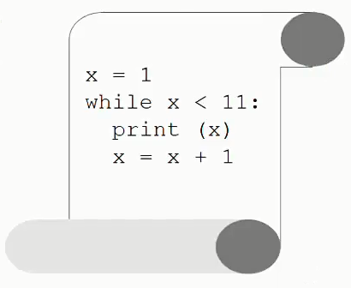
Python is a (relatively simpler scripting language – ideal for UDFs
Intuitive syntax
Dynamic typing
Interpreted execution
Python is pre-installed on Cloudera VM
Python 2.6.6 supports streaming for Hive
Jython (a Java implementation of Python) has native support in Pig

Slide 11
How do I use Python UDF in Pig?
Pig natively support Jython
Define the output scheme as a Pig bag
@outputSchema(“resule: {(a:chararray, b:int)}”)
Def myfunction(i):
…
return a, b

Slide 12
Use the Pig FOREACH … GENERATE statement to invoke a UDF
REGISTER ‘myscript.py’ using jython as myfunction;
Src = LOAD ‘/data/source’ AS (row:chararray);
Res = FOREACH src GENERATE myscript.myfunction(row);

Slide 13
How do I use a Python UDF in Hive?
Hive exchanges data with Python using a streaming technique
Rows from Hive are passed to Python through STDIN
Processed rows from Python are passed to Hive through STDOUT
line = sys.stdin.readline()
print processed_row

Slide 14
Use the Hive TRANSFORM statement to invoke a UDF
add file ‘/data/…’
SELECT TRANSFORM (col1, col2, col3)
USING ‘python myscript.py’
AS (col1 STRING, col2 INT, col3 STRING)
FROM mytable
ORDER BY col1;

Slide 15
What is Oozie?

